Slide 1



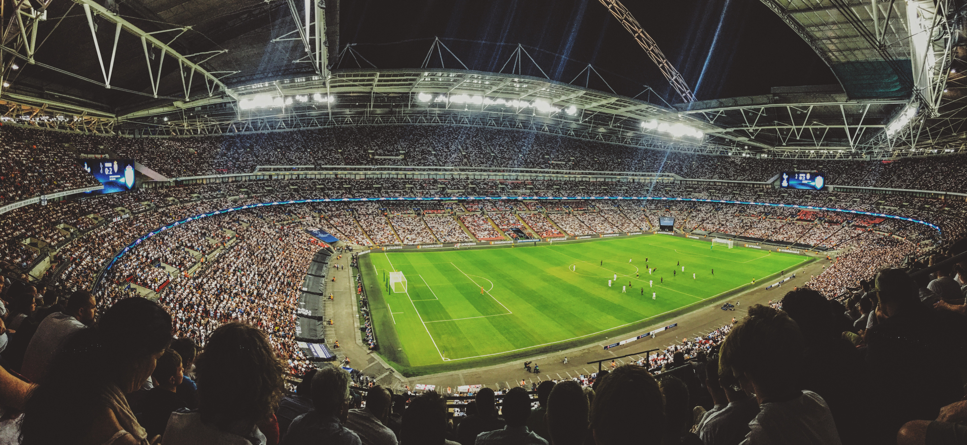




UNVEILING FOOTBALL BRILLIANCE: A DATA ODYSSEY IN UEFA CHAMPIONS LEAGUE
EXPLORING INSIGHTS FROM THE 2021-2022 SEASON
Name: Abhishek Kumar Singh
Reg.No:12113396
Roll No:RK21URA02

Slide 2


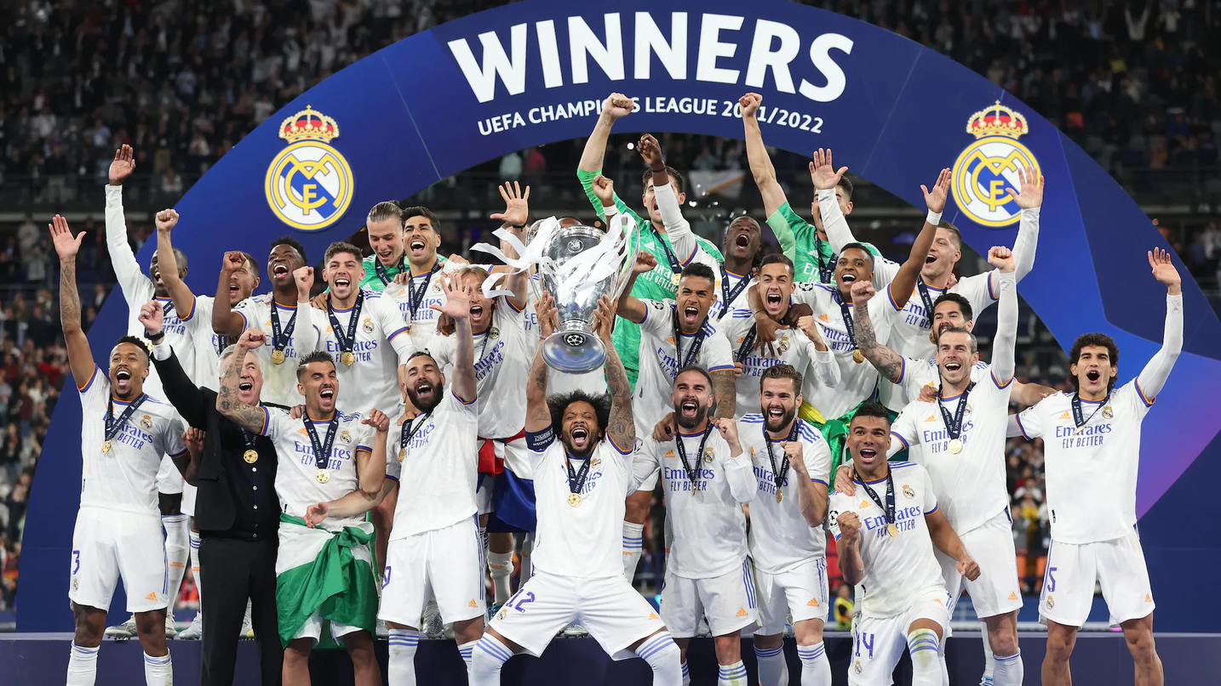
INTRODUCTION
1955-1960S: BIRTH OF A LEGACY
The UEFA Champions League, a pinnacle in club football, unites elite European teams annually in a thrilling showcase of skill and competition, captivating fans worldwide.
1970S-1980S: EXPANSION AND GLOBAL RECOGNITION
1990S: THE ERA OF FORMAT CHANGES
2016: REAL MADRID'S 11TH TITLE
2010S: SPANISH DOMINANCE AND VAR INTRODUCTION
2023: ONGOING LEGACY IN FOOTBALL HISTORY

Slide 3



Project overview
PRIMARY GOALS
OBJECTIVES
METHODOLOGY
The primary goal the project is to explore player and team performance in the 2021-2022 season via various EDA methods and visualization
Outline specific objectives, like identifying top performers, analyzing scoring patterns, and understanding team dynamics.
Provide a concise overview of the methodology used for data analysis, including data collection and tools employed.

Slide 4
Decoding Football Metrics
Concepts: The key metrics are
goals
assists
defense
passing
field control
GK Data,etc.
Challenges
Challenges encountered during data analysis were:
Data quality
Data Granularity
Contextual Understanding
Certificate of Completion
Comparative Analysis
Feature Engineering

Slide 5



A Passionate Choice
immersing myself in the UEFA Champions League dataset is more than an analytical endeavor—it's a passionate tribute to the sport I love. Inspired by the grandeur of football and the remarkable journey of Cristiano Ronaldo, this project aims to unravel the statistical tapestry woven on the grand stage of the beautiful game.
FC Real Madrid
Cristiano ronaldo
FC Barcelona

Slide 6




Inside the numbers
24
12
8
16
Univariate analysis
Bivariate analysis
Multivariate analysis
HYPOTHESIS TESTING

Slide 7


Univariate Analysis
Univariate analysis involves the examination of a single variable in isolation, providing insights into its distribution and characteristics. In the context of our UEFA Champions League dataset, univariate analysis helps us understand the individual player or team metrics
In our project, we employ univariate analysis to scrutinize variables like goals, assists, passing accuracy, and other individual metrics. This allows us to identify patterns, trends, and outliers within each variable, paving the way for deeper insights into player and team performance. By analyzing variables independently, we lay the groundwork for a comprehensive understanding of the dataset.

Slide 8

Bivariate analysis
Bivariate analysis delves into the relationships between two variables, unraveling connections that may exist between them. In our UEFA Champions League dataset, this means exploring how two metrics interact and influence each other.
Within our project, bivariate analysis is instrumental in uncovering connections such as the correlation between goals and assists or the relationship between possession and match outcomes. By scrutinizing pairs of variables, we gain nuanced insights that go beyond univariate exploration. This analysis method paints a richer picture of how different aspects of player and team performance interrelate within the dataset.

Slide 9

Hypothesis
TESTING
Interpreting the results of hypothesis testing provides insights into whether observed differences or patterns in the data are statistically significant. This step allows us to make informed decisions about player and team characteristics, adding depth to our exploratory data analysis.
Null Hypotheses:
The average number of goals per match is equal to the league's historical average.
Alternative Hypotheses:
The average number of goals per match differs significantly from the league's historical average."

Slide 10
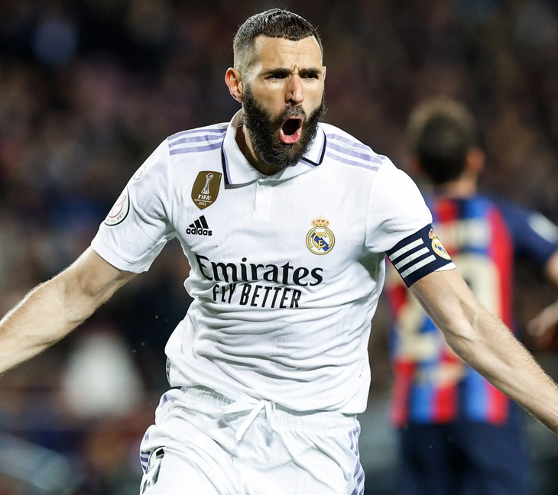
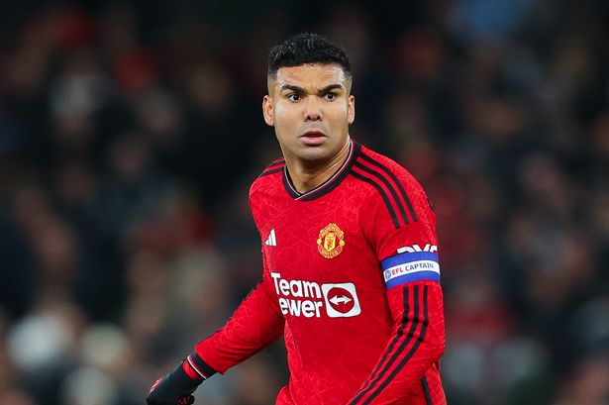
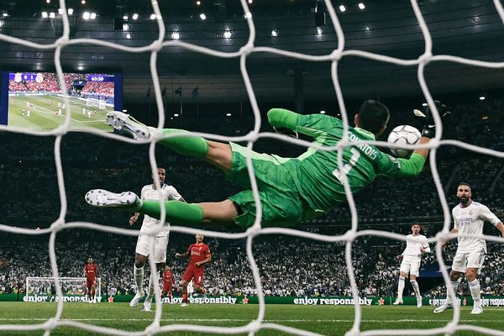
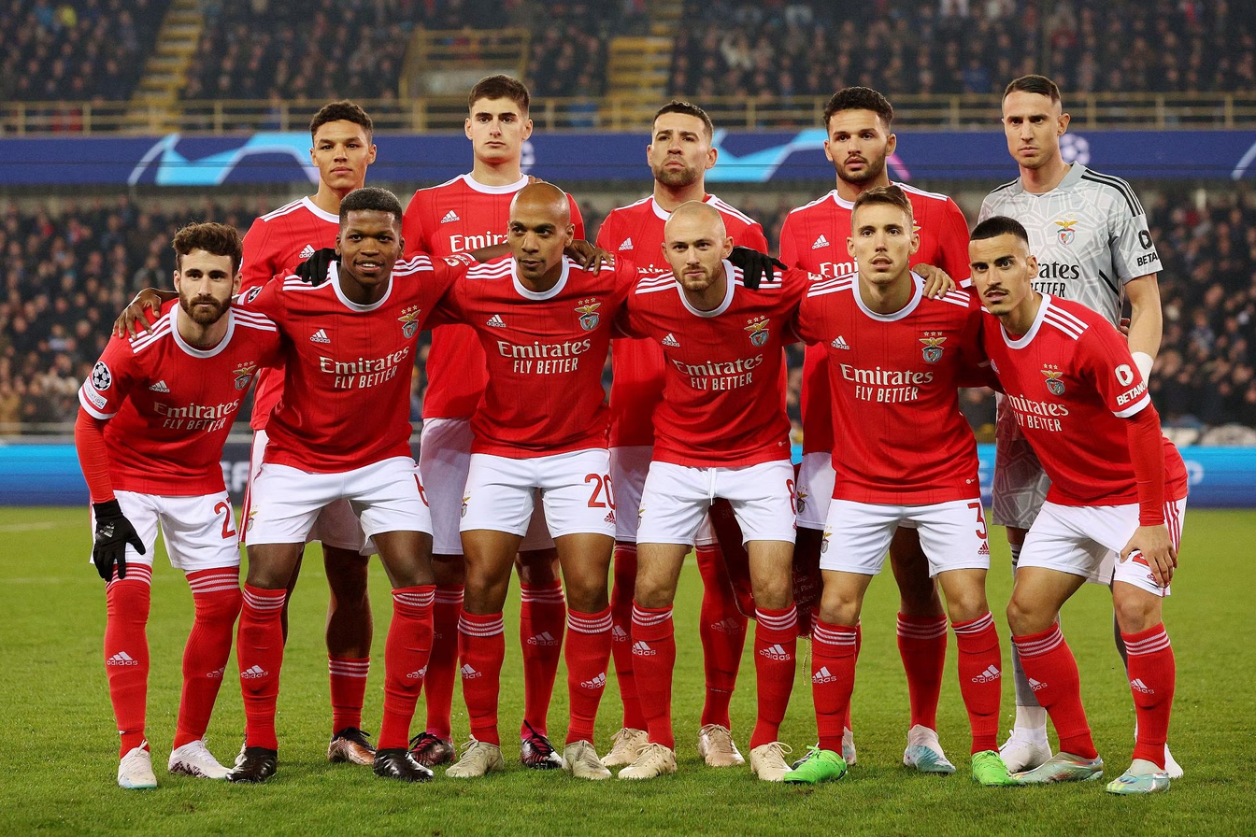
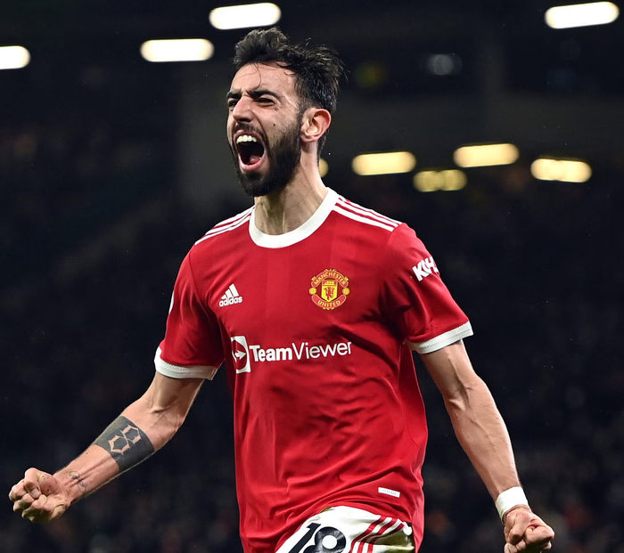
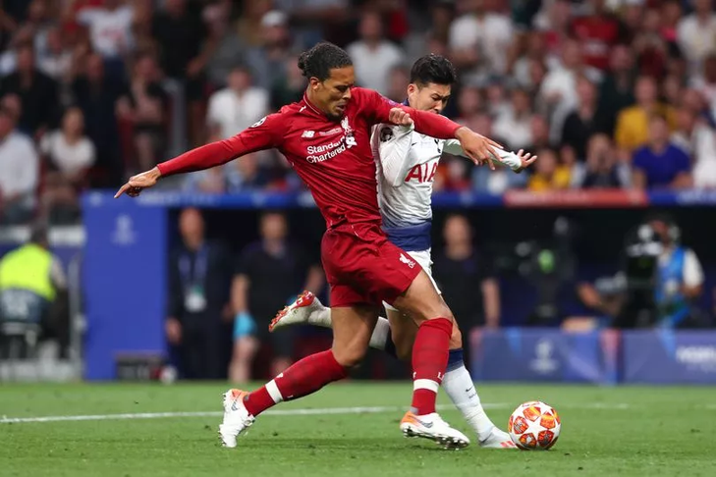
TOP SCORER
DEFENSIVE GAME PLAY
BEST GOALKEEPER
REVEALING FOOTBALL’S SECRETS

Slide 11







STRATEGIC BRILLIANCE
Goal Distribution ,Assist Patterns ,Possession and Field Control,Clean Sheets,Tackling Efficiency, Free Kicks and Corners,Defending Set-Pieces.

Slide 12
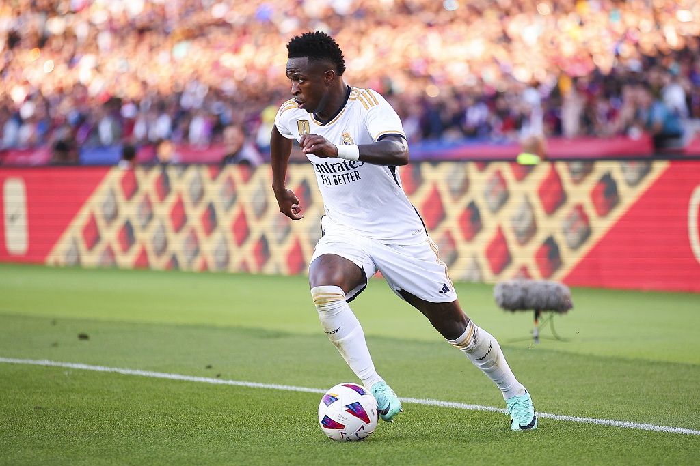



UEFA Champions League
UNCOVERING RISING STARS
Emerging Goal Scorers,Creative Playmakers,Solid Defenders,Versatile Players

Slide 13


UEFA Champions League
DATA-DRIVEN FOOTBALL
Description
Growing Role of Data:
Strategic Planning
Player Recruitment
Embracing data-driven football is not just a choice but a necessity in the modern era.
The evolving landscape of the sport is characterized by a fusion of traditional football wisdom and cutting-edge data analytics, shaping the future of the beautiful game.

Slide 14

Soccer Club
Deep Dive into Football Insights :
Passion Meets Analysis:
The project offered a comprehensive exploration of UEFA Champions League data, unraveling intricate details of player and team performance.
The intersection of football fervor and analytical skills created a unique journey, blending the love for the sport with the rigor of data exploration.
IN THE SPIRIT OF FOOTBALL
Presentations are tools that can be used as
lectures, speeches, reports, and more. It is mostly
presented like before an audience.

Slide 15
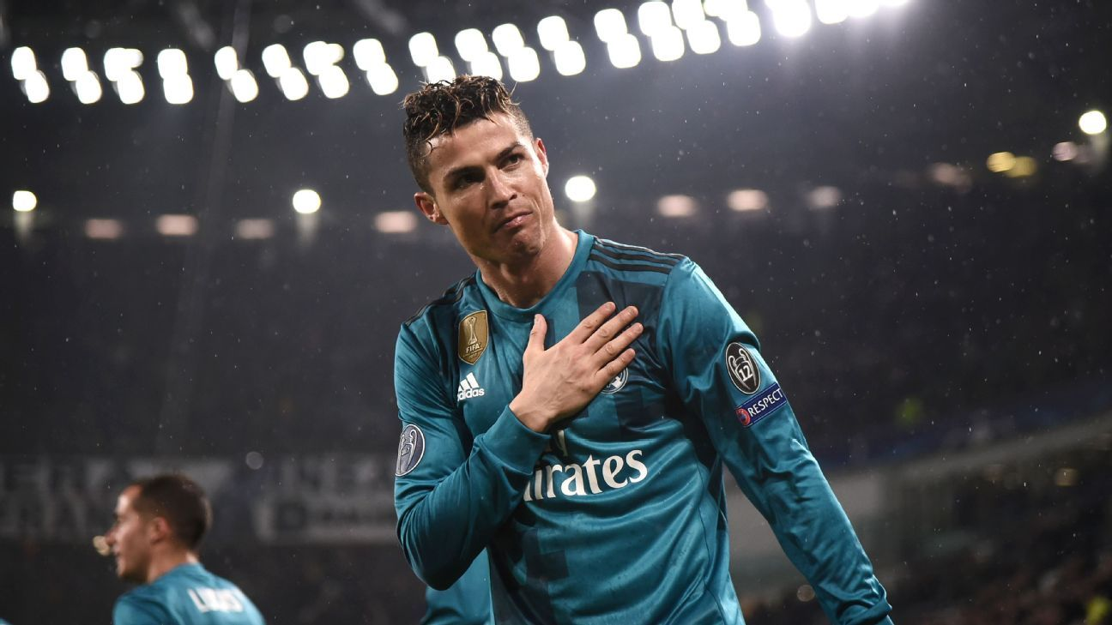

UEFA Champions League
THANK
YOU
Thank you for joining this football data exploration journey!
End Of Slide

